Slide 1
Employee Salary Classification using Machine Learning
CAPSTONE PROJECT
Presented By:
Student Name :- SAMBHERAO PRATIK MAHADEV
Student ID :- STU682971f5985c21747546613
College Name :- JAIHIND COLLEGE OF ENGINEERING
Department :- Computer Engineering

Slide 2
OUTLINE
Problem Statement (Should not include solution)
System Development Approach (Technology Used)
Algorithm & Deployment (Step by Step Procedure)
Result
Conclusion
Future Scope(Optional)
References

Slide 3
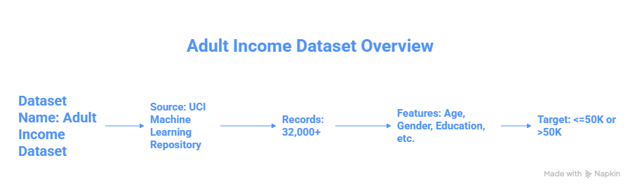
Problem Statement
This project aims to develop a Machine Learning model that classifies whether an individual earns more than $50K annually based on attributes like Age, Work Class, Education, Occupation, Hours-Per-Week, and more.
The dataset used is the Adult Income Dataset from UCI.
The goal is to create an Automated, Accurate, and Deployable Prediction System for salary classification.
This helps organizations streamline HR decisions and analyze workforce income trends. Challenges include handling missing values, outliers, and categorical encoding.
Automates decision-making using Data-Driven Insights, Real-world relevance in finance, HR, and sociological analysis

Slide 4
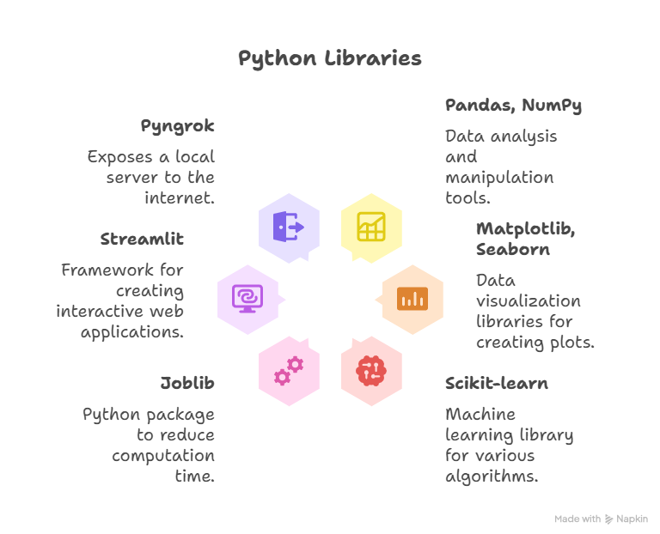
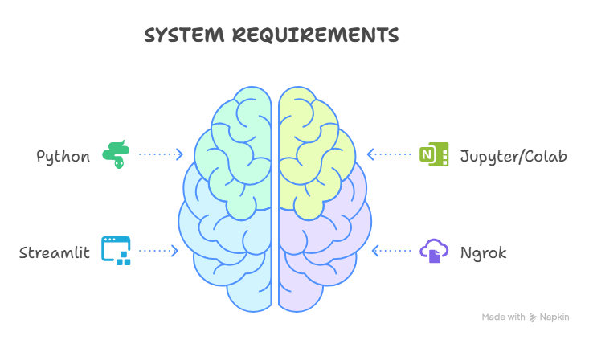
System Approach

Slide 5
Algorithm & Deployment
Step-by-step Procedure:
Load & clean dataset (remove nulls, outliers, '?' entries)
Preprocess (encode categorical, normalize, impute)
Split data into train/test (80/20)
Train various ML models:
KNN
SVR
MLP Classifier
Naïve Bayes
Bagging(Decision tree)
Ada boost
Compare model accuracy and select the best
Save best model as best_model.pkl
Deploy using Streamlit + Ngrok for real-time predictions

Slide 6
Result
Best Accuracy:
AdaBoost Classifier
Accuracy Scores:
KNN: ~0.79
SVR: ~0.74 (with thresholding)
MLP: ~0.84
Gaussian NB: ~0.80
Bagging: ~0.85
AdaBoost: ~0.86
🌐 Deployment Output:
Hosted Streamlit app using Ngrok: https://your-ngrok-link.ngrok-free.app
http://localhost:8000
Git-hub link :https://github.com/Pratikms10/projectaiml.git

Slide 7
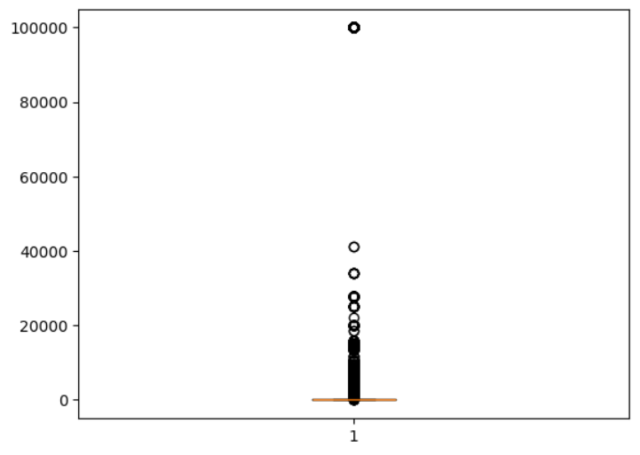
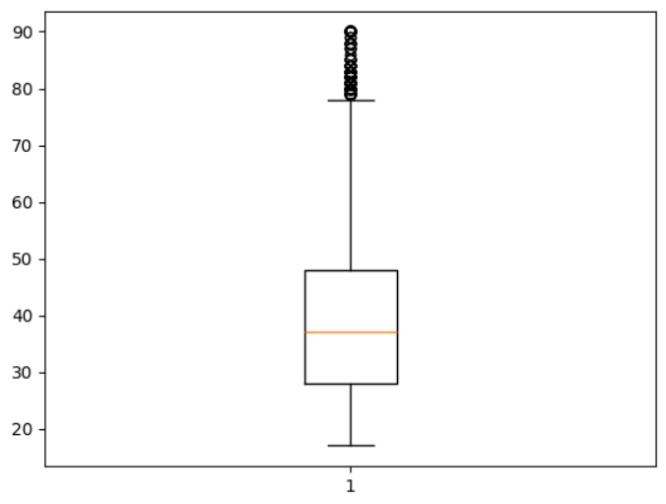
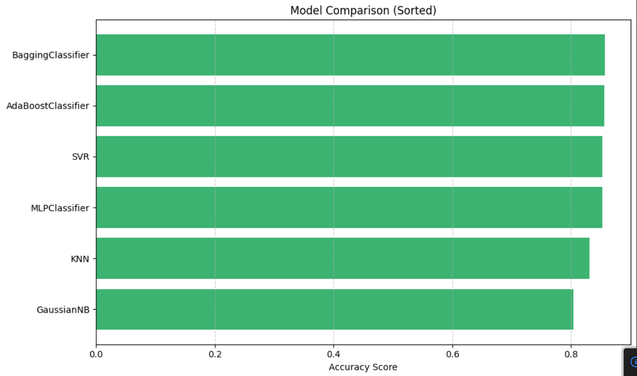
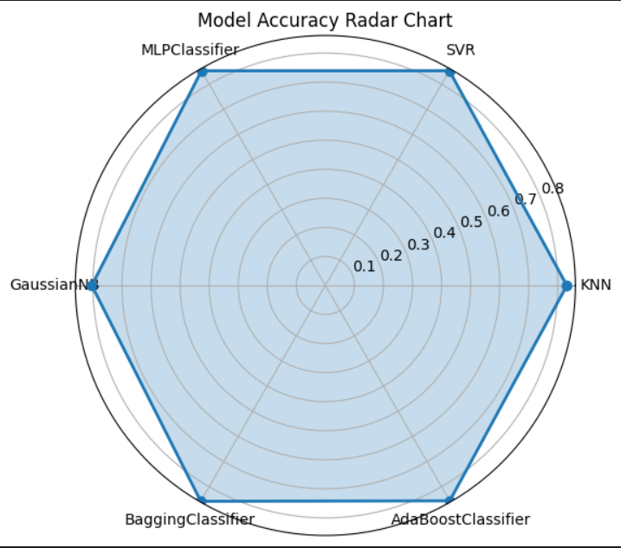
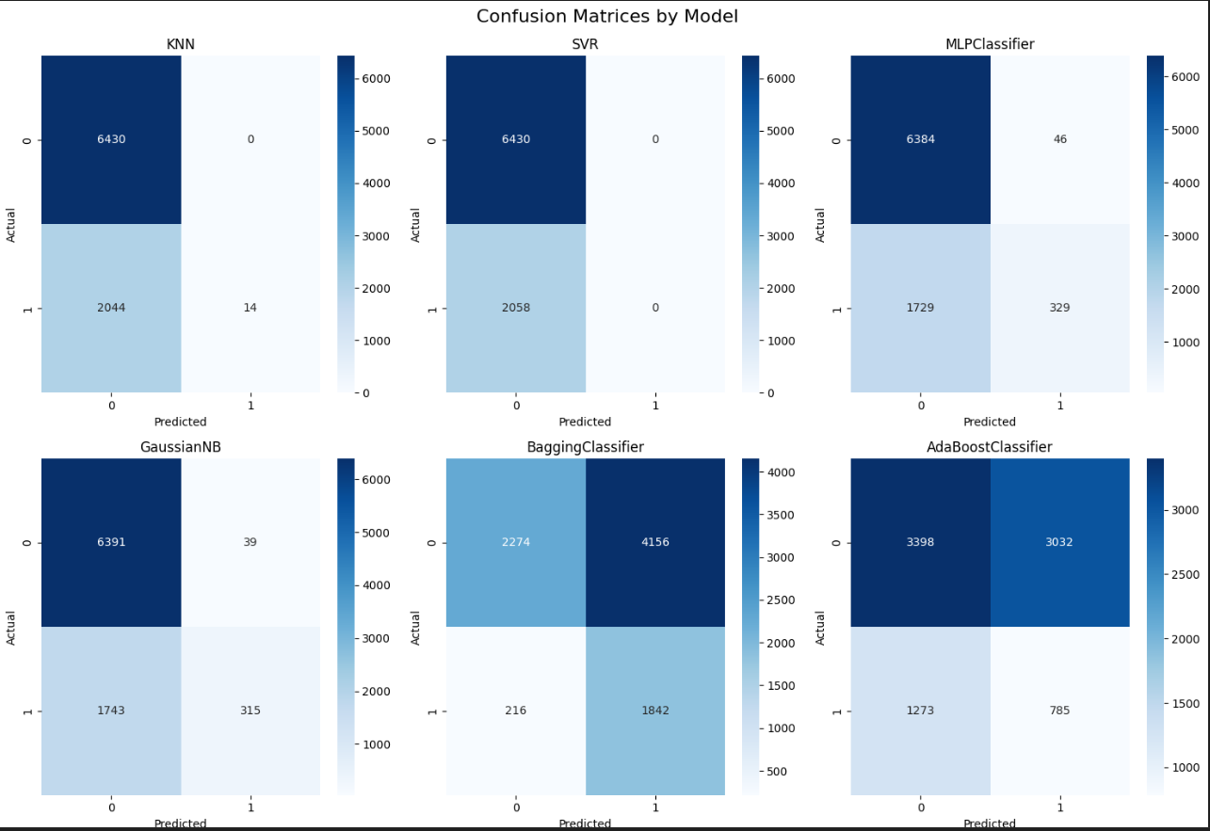
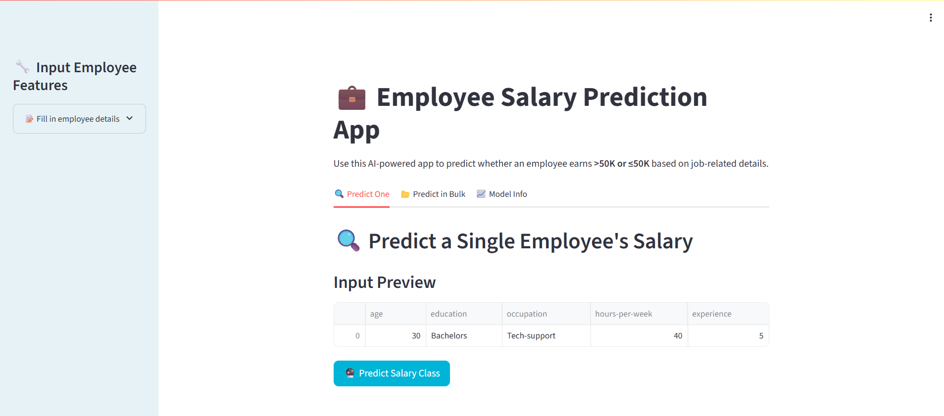
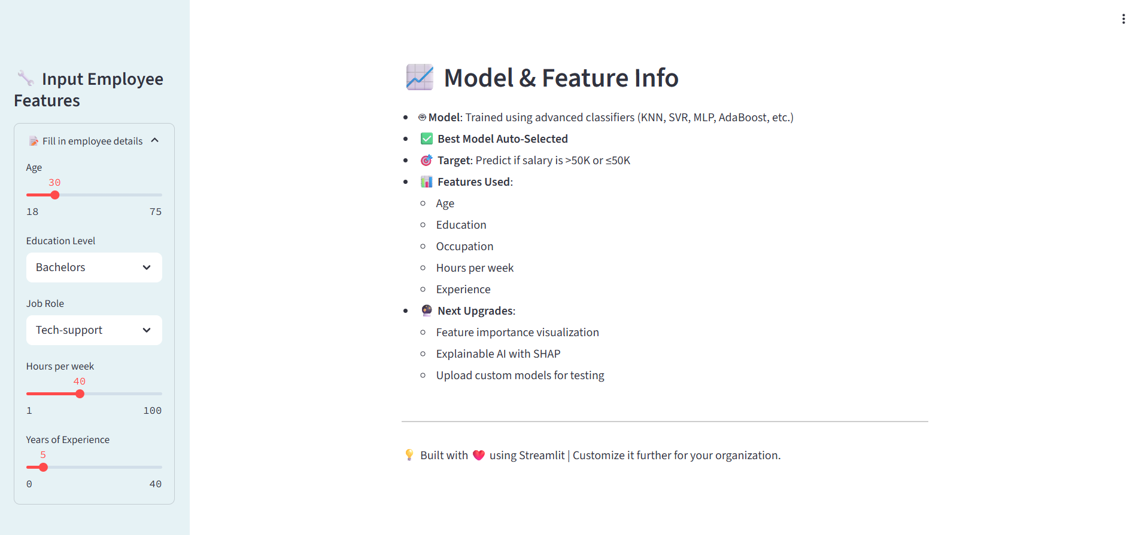
Result

Slide 8
Conclusion
The project successfully classifies salary categories using various ML models.
AdaBoost Classifier gave the best accuracy after rigorous comparison.
All models were standardized using pipelines.
The deployment enables both individual and bulk predictions.
Challenges included managing categorical data and model tuning.
This solution demonstrates strong practical use for HR analytics.

Slide 9
References
UCI Adult Dataset
Scikit-learn Documentation
Stream lit Docs
Medium & Towards Data Science articles on ML Pipelines
Reena, S. K., & Rabbani, S. S. (2025). Adult Income Classification using Machine Learning Techniques. JES Publications, Vol. 16(5), pp. 123–130. https://jespublication.com/uploads/2025-V16I50123.pdf
Chakrabarty, N., & Biswas, S. (2018). A Statistical Approach to Adult Census Income Level Prediction. arXiv preprint arXiv:1810.10076. https://arxiv.org/abs/1810.10076

Slide 10
THANK YOU

